Slide 1
Team Project - 6
DSA PROJECT
G
H
T
Project By : Monish & Ashutosh

Slide 2
Human resources slide 1
G
eneralised
This project is based on
H
yperplane
SEARCHING
T
ree

Slide 3

G
eneralised
}
( x₁ , x₂ , …............... , x_{n})
n – dimensional point

Slide 4
Human resources slide 1
G
eneralised
( x₁ , x₂ , …............... , x_{n})
H
yperplane
T
ree

Slide 5
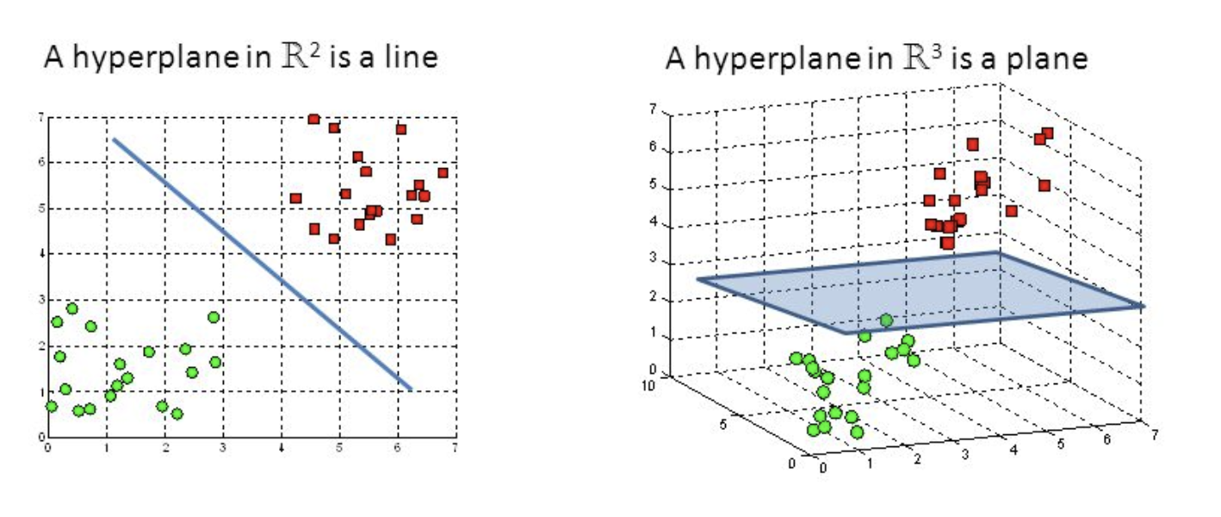
Human resources slide 1
H
yperplane

Slide 6
Human resources slide 1
G
eneralised
( x₁ , x₂ , …............... , x_{n})
H
yperplane
T
ree

Slide 7
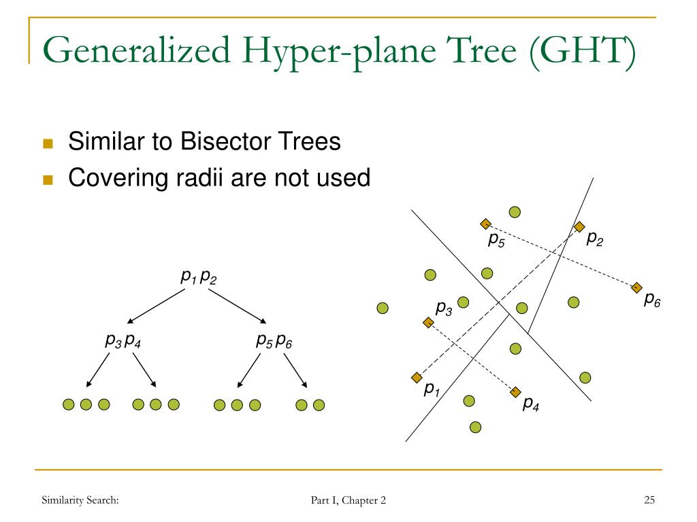
Human resources slide 1
T
ree
Pivot 1
Pivot 2

Slide 8
Human resources slide 1
T
ree
Tree is helpful in pruning most of the undesirable points
Stores pivots used in partitioning

Slide 9



Applications

Slide 10
Applications
Google:
Search near me feature
Your current location is a query point, there is already a GHT of all restaurants in that city. Using updated version of GHT we can find more than 1 neighbours.

Slide 11
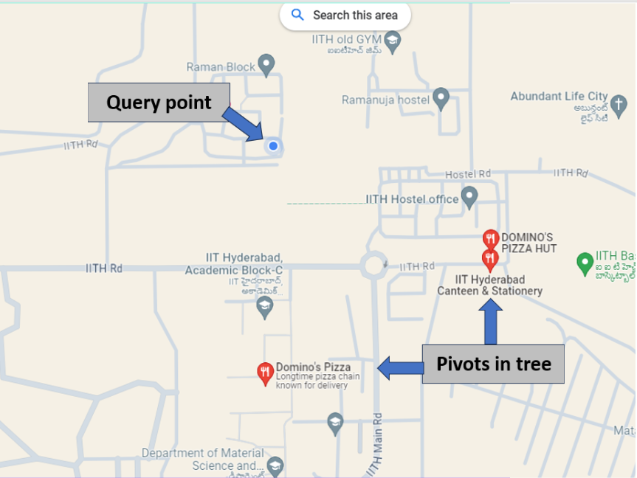
Applications

Slide 12
Applications
Health-care:
Faster diagnosis
Organizing data from MRI scans or other tests. It helps in finding the most probable disease based on the data received. The disease to which the nearest neighbour point is pointing is the most probable disease, which helps in faster diagnosis.

Slide 13
Applications
Finance:
It can also be used in Finance section, in risk assessment, analysing stock market trends, etc .

Slide 14

Human resources slide 7
Key Takeaways
Data structures we used in project:
Trees, inspired from normal Binary Search tree for insertion of Pivots.
Used vectors for storing unknown number of points
25%
50%
75%
100%

Slide 15
Human resources slide 7
Key Takeaways
Time and Space Complexity of GHT :
Space complexity of GHT is O(n)
Where n is number of points in tree.
Time complexity:
Find_pivots & create_sub_groups : O( n )
Insert & finding neighbour
: O( log(n) )
Recursive_partition
: O( nlog(n) )
25%
50%
75%
100%

Slide 16
Human resources slide 7
Key Takeaways
Comparing Different Distance formulas :
{ Euclid , Manhattan } they give nearest neighbour with almost equal accuracy.
But Chebyshev, have least accuracy in most cases. (less preferable )
25%
50%
75%
100%

Slide 17
Human resources slide 7
Key Takeaways
Effect of Increasing Dimension on algo :
Increasing the dimension is a curse for this algorithm.
The data points become sparser in the space.
This decreases the accuracy of comparison.
25%
50%
75%
100%

Slide 18
Human resources slide 4
MAIN CHALLENGE:
Not many research papers on concept of GHT are available
CHALLENGES FACED

Slide 19
Human resources slide 4
MAIN CHALLENGE:
Not many research papers on concept of GHT are available
CHALLENGES FACED

Slide 20
Human resources slide 4
CHOOSING PIVOTS:
Selection of good pivots is hard, to think about the far away points
CHALLENGES FACED

Slide 21
Human resources slide 4
CHOOSING PIVOTS:
Selection of good pivots is hard, to think about the far away points
MAIN CHALLENGE:
Not many research papers on concept of GHT are available
CHALLENGES FACED

Slide 22
Human resources slide 4
PARTITIONING ALGO:
Some best algo’s suggested for partition like k-means, are not easy to implement in C++
CHALLENGES FACED

Slide 23
Human resources slide 4
PARTITIONING ALGO:
Some best algo’s suggested for partition like k-means, are not easy to implement in C++
CHOOSING PIVOTS:
Selection of good pivots is hard, to think about the far away points
MAIN CHALLENGE:
Not many research papers on concept of GHT are available
CHALLENGES FACED

Slide 24
Human resources slide 4
NEAREST NEIGHBOUR ACCURACY:
The algo does not always give the nearest neighbour
CHALLENGES FACED

Slide 25
Human resources slide 4
PARTITIONING ALGO:
Some best algo’s suggested for partition like k-means, are not easy to implement in C++
CHOOSING PIVOTS:
NEAREST NEIGHBOUR ACCURACY:
Selection of good pivots is hard, to think about the far away points
The algo does not always give the nearest neighbour
MAIN CHALLENGE:
Not many research papers on concept of GHT are available
CHALLENGES FACED

Slide 26
Human resources slide 4
DELETION POLICY:
For deletion if pivot gets deleted we have to build tree again. Too expensive.
CHALLENGES FACED

Slide 27
Human resources slide 4
PARTITIONING ALGO:
Some best algo’s suggested for partition like k-means, are not easy to implement in C++
CHOOSING PIVOTS:
NEAREST NEIGHBOUR ACCURACY:
Selection of good pivots is hard, to think about the far away points
The algo does not always give the nearest neighbour
MAIN CHALLENGE:
DELETION POLICY:
Not many research papers on concept of GHT are available
For deletion if pivot gets deleted we have to build tree again. Too expensive.
CHALLENGES FACED

Slide 28
Human resources slide 2
References
https://www.researchgate.net/figure/Generalized-Hyperplane-Tree-GHT-a-hyperplane-partitioning-and-both-the-partitions_fig10_248599583
https://www.researchgate.net/figure/Address-Search-Tree-with-the-generalized-hyperplane-partitioning_fig1_313049328

Slide 29
Thank You
Roll no:
MA22BTECH11014 & MA22BTECH11007

